Slide 1
Agent-Based Modelling for Ecologists
Tutorial Tuesday
AKA go go NetLogo
After Romanowska, Wren & Crabtree (2021)

Slide 2
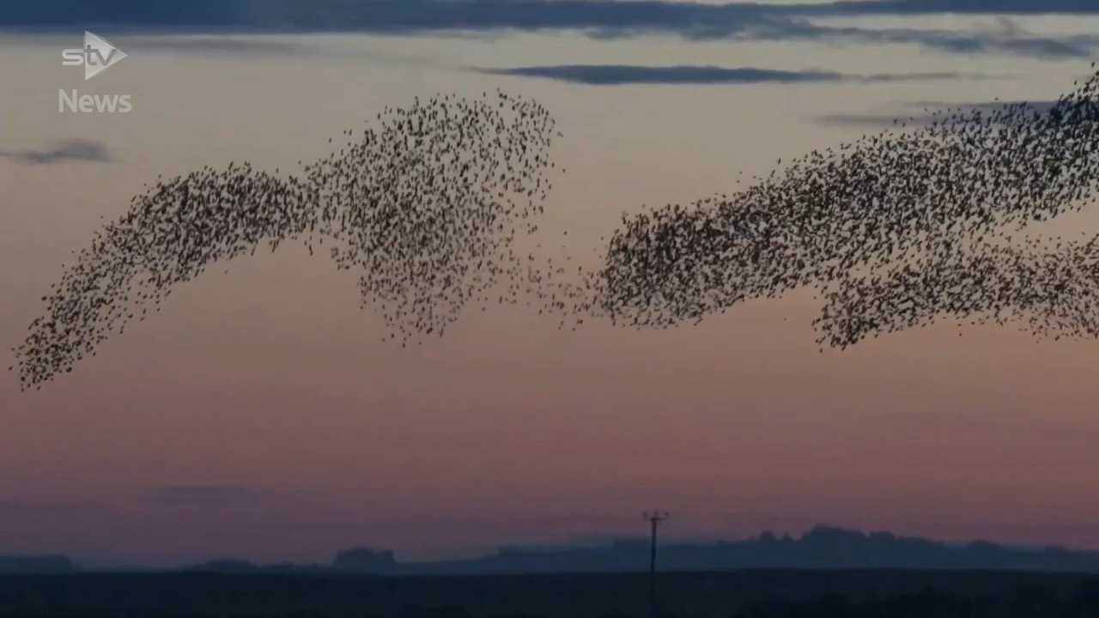
Video source
Notes:
How to model this?
Newtonian forces of attraction and repulsion? You would run into the n-body problem astrophysics has had to deal with for ages. (Impossible to predict the future position of n > 2 bodies from their initial positions and velocities if they exert a force on each other). Through numerical methods, sure.
A flow equation maybe? This looks more or less liquid, no? Sure, we all loved those courses so much.

Slide 3
Modelling a murmuration?
Avoid neighbours
Fly ± same speed and direction as neighbours
Stay close to neighbours
Sum > Parts
+
Reynolds (1987)
Notes:
Actually, it’s much simpler.
Emergent properties ➔ Complex behaviour
Several examples: fireflies flicker synchronously. In order to achieve this, it would be enough for every firefly to imitate 2 neighbours.

Slide 4
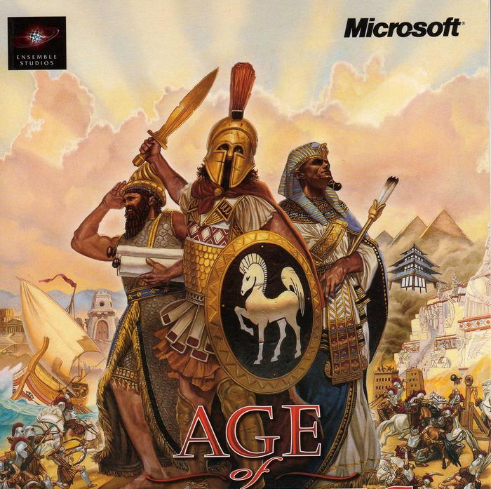
Agent-Based Modelling

Slide 5
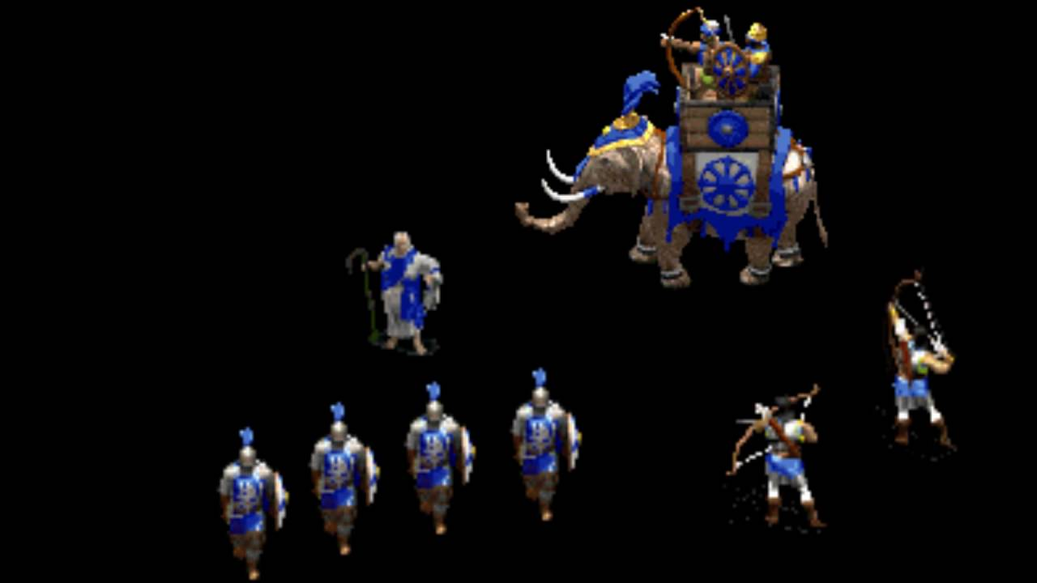
Age of ABM
Characters…

Slide 6
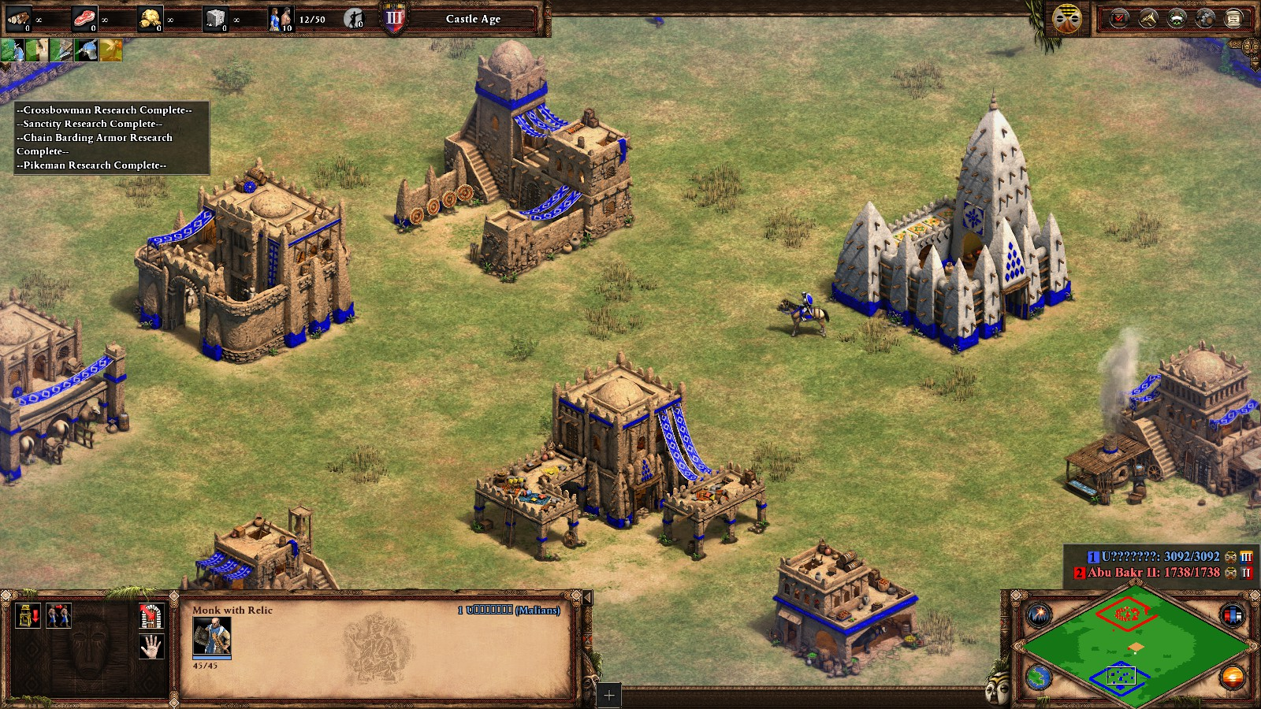
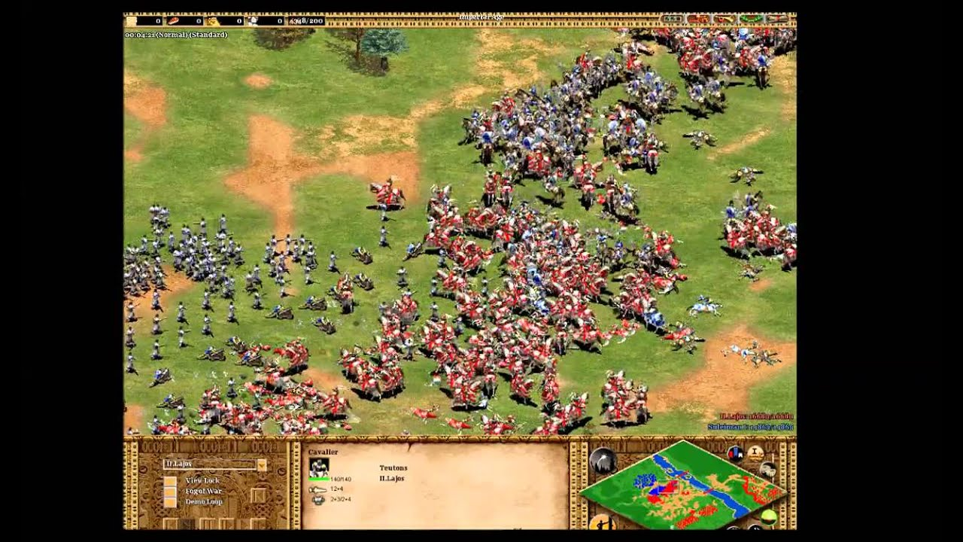
Age of ABM
Characters…
… doing something…
By themselves
With each other

Slide 7
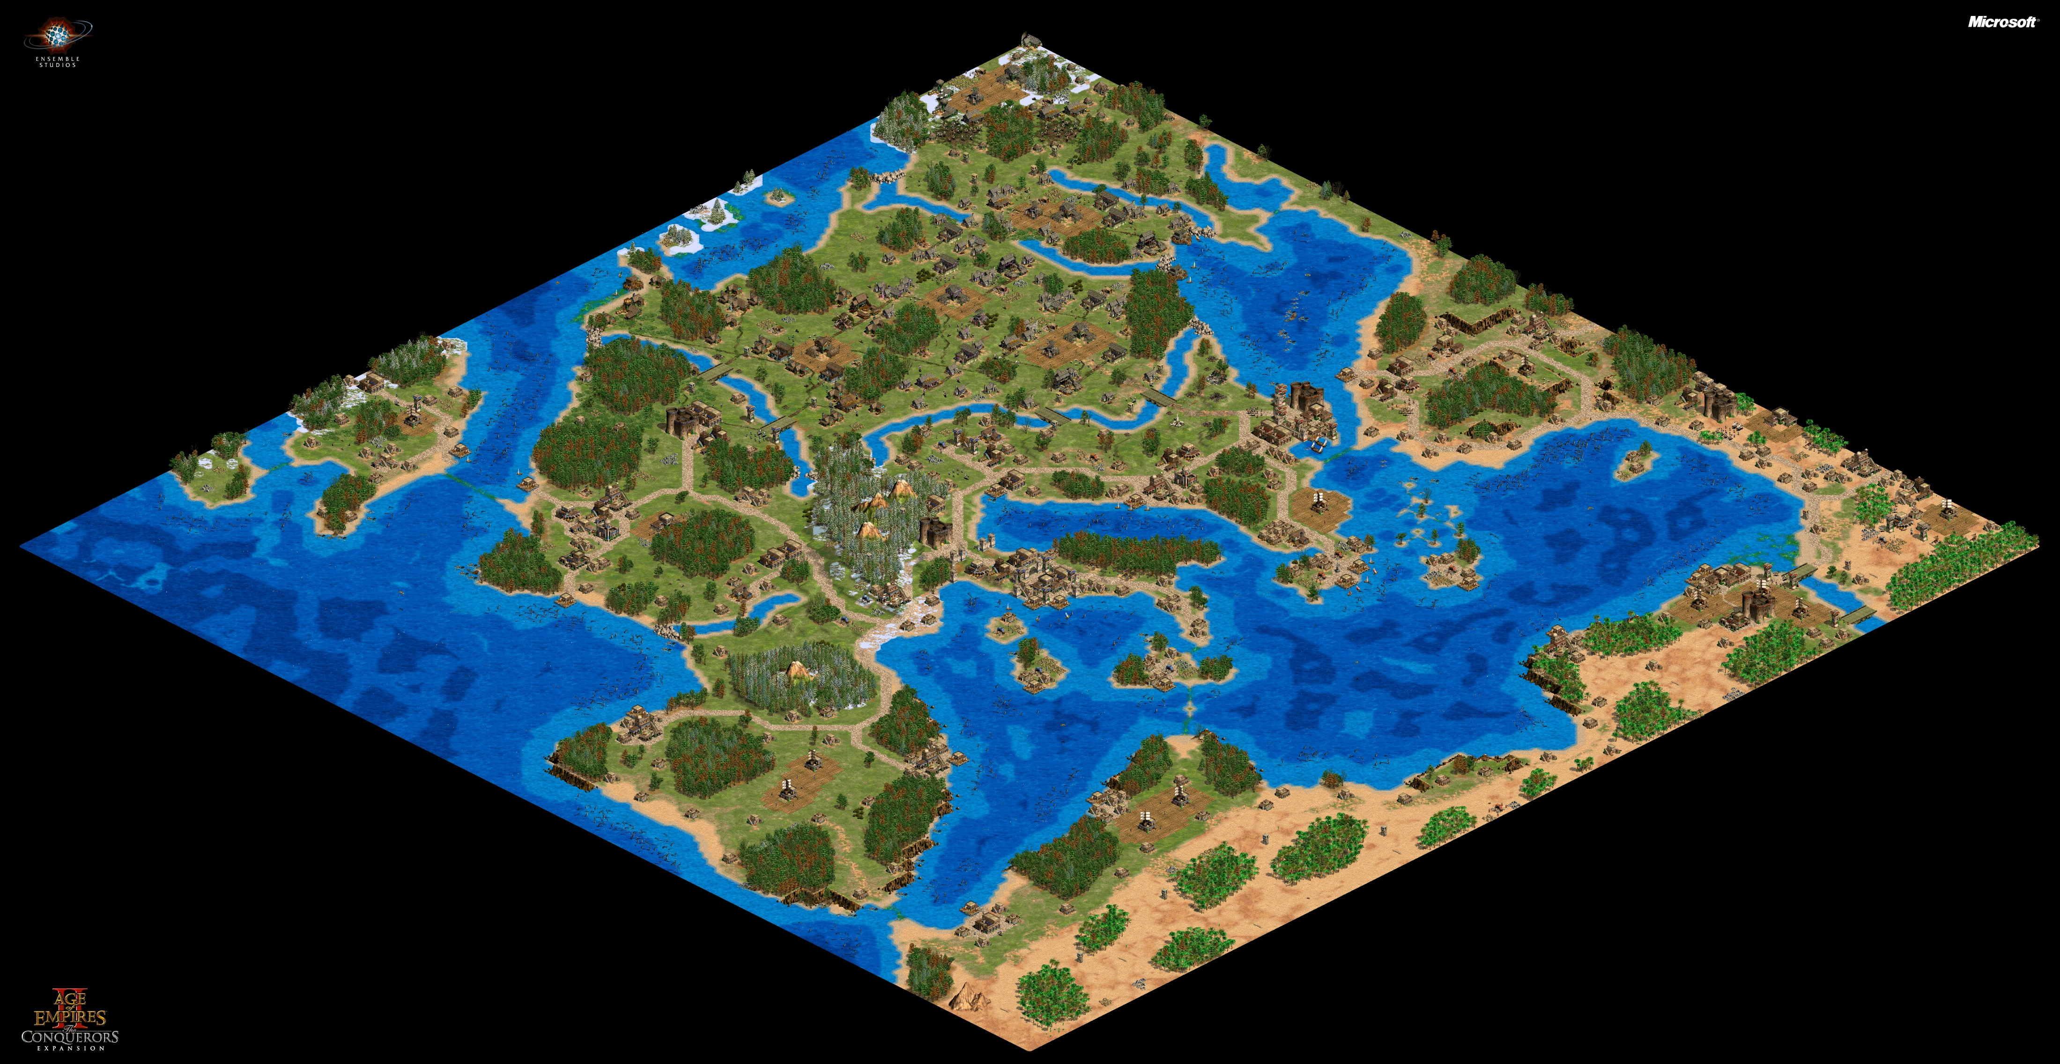
Age of ABM
Characters…
… doing something…
By themselves
With each other
… in an environment.

Slide 8

Game over
Individual – heterogeneous – autonomous units
= agents
Rules of behaviour
= actions and interactions
Temporal and spatial dimensions
Notes:
ABM is one possible approach to model complex systems.

Slide 9
When to use?
Actions and interactions of individual agents lead to larger, unpredictable structures
= Emergent properties
Heterogeneity among interacting agents
Interaction dynamics unfold over time and/or space
System may learn or adapt
Notes:
Flock = emergent property. Couldn’t have predicted from individuals or from ruleset
Heterogeneity = different characters in our game have a different goal. Some may be soldiers, other ones farmers. What happens if there’s more of one than the other?
Perhaps all too actual: modelling spread of current pandemic necessitates the use of explicit timescales and real-world distances between infection hotspots.
Rules of the game may change. What if the virus mutates for instance, or if we vaccinate ourselves? Or if we refuse to get vaccinated?

Slide 10
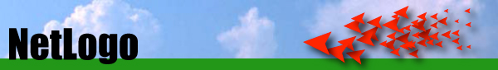
“Low threshold and no ceiling”
Notes:
I hope this brief introduction has gotten you thinking about what processes relating to your research you might be able to capture in an ABM. I’m going to stop talking about the WHAT for now, and will get you directly into the HOW. For this tutorial, we will be using NetLogo, a programming language and integrated development environment, designed by Uri Wilensky. Slogan: schoolchildren can already understand the language, because it’s written to resemble natural language as closely as possible. “No ceiling”: the possibilities are limitless and NetLogo can handle thousands of agents with ease. The trade-off to all this is… it looks worse than the first Age of Empires game. Let’s take a look.

Slide 11
NetLogo basics
Agents:
Turtles = ‘traditional’ agent
Patches = raster pixels representing the environment
Observer = you, the user

Slide 12
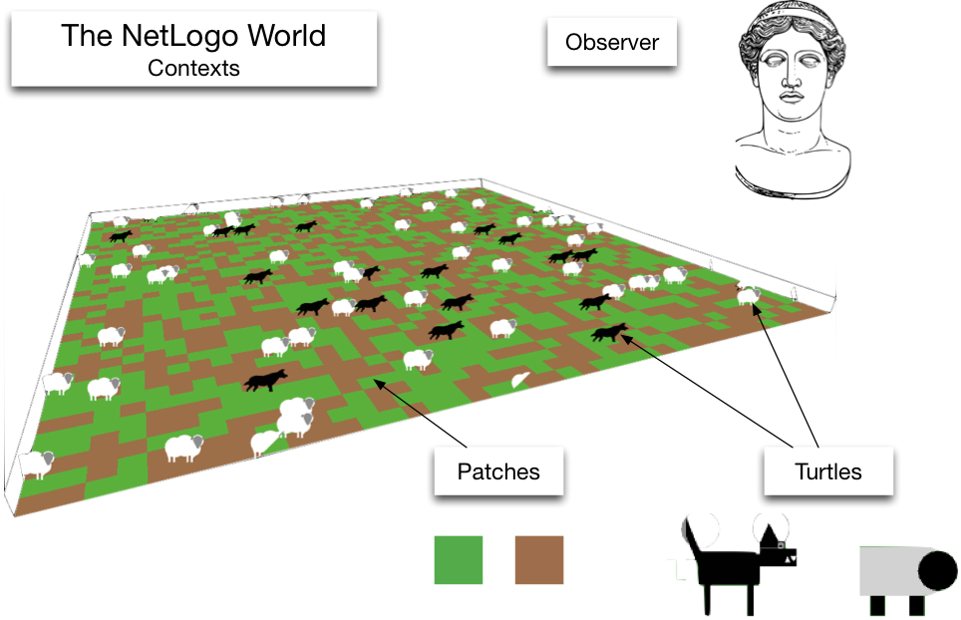
Image source

Slide 13
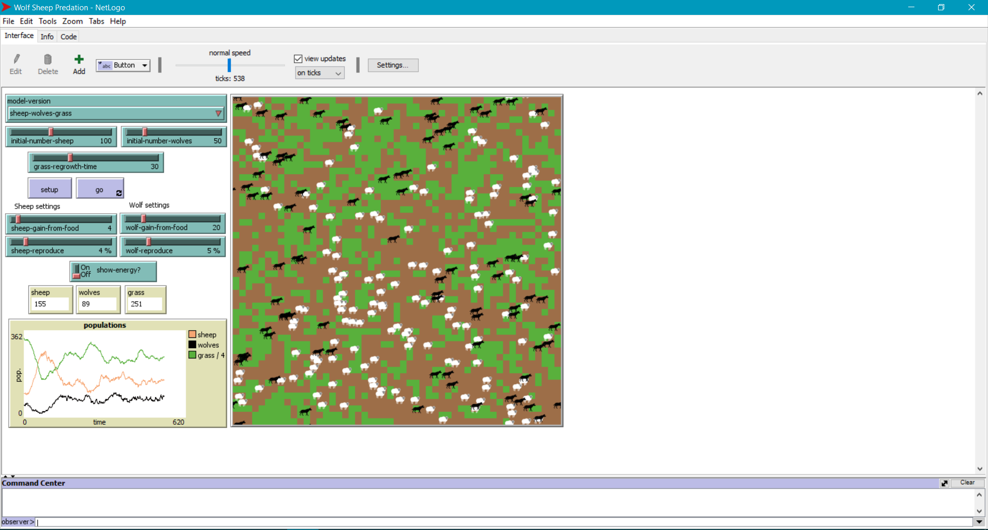
Notes:
Elements on screen: three tabs, self-explanatory.
Interface tab: upper left, green boxes = user inputs. Sliders setting an input between a min and max value, selection box with preset options, on/off switch for additional options. Down that: three boxes containing real-time counters of the agentsets of interest. Below that: plot showing the same information along a time axis. Right: graphical representation of the model running. Command center at bottom: where observer types commands (at all times).

Slide 14
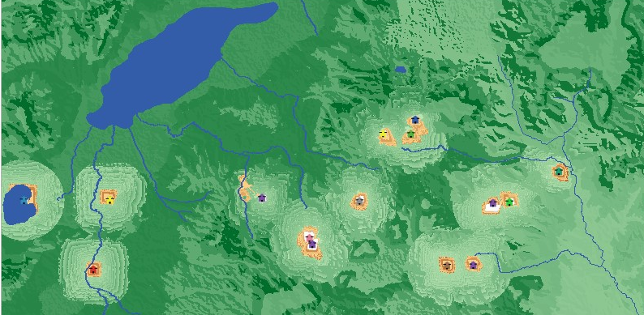
NetLogo advanced
GIS extension:

Slide 15
NetLogo advanced
Call NetLogo from R:
RNetLogo package
nlrx package (still experimental)
Call R from NetLogo:
- NetLogo-R-Extension

Slide 16
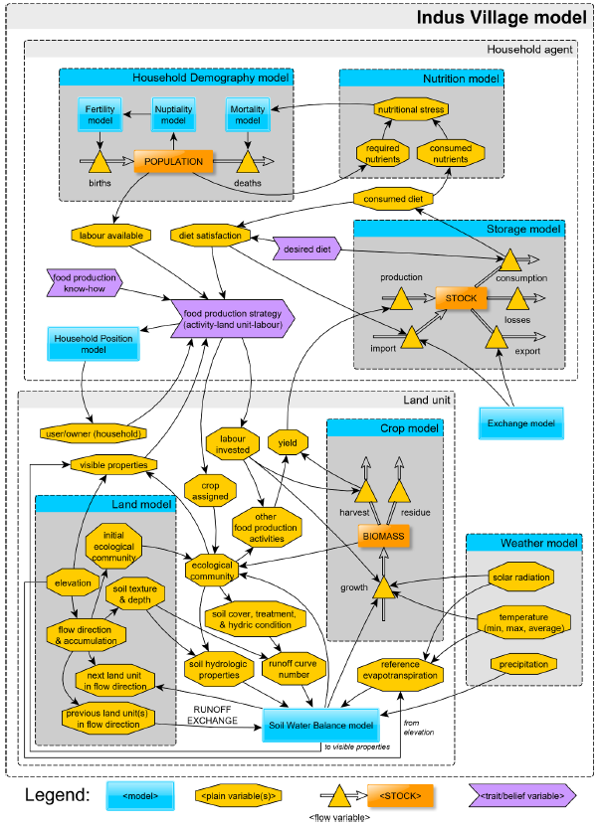
NetLogo Final Form
There is such a thing
as too much of a good thing.
Angourakis et al. (2020)

Slide 17
What about the code?
Fire up NetLogo and get cracking.
Notes:
By means of introduction, we will be recreating the grass-sheep-wolf model.

